Slide 1
Fritz Mader (1872-1921)
Pioneer of the Natural History of the Maritime Alps
Graham Avery
Bordighera, 20 November 2022
Notes:
1

Slide 2
Fritz Mader (1872-1921)
Alpinist, botanist, glaciologist, speleologist, historian, photographer
Author of many publications on the Maritime Alps
He contributed to the work of the Swiss botanist Emile Burnat (1828-1920), author of Flore des Alpes Maritimes
In 1897 he launched Clarence Bicknell (1842-1918) on the path of exploring the prehistoric rock engravings
In 1914 he proposed a national park in the Argentera; it was not until 1980 that the Parco Naturale dell'Argentera was created
Notes:
2

Slide 3
1872 Born in Nice, son of the Lutheran pastor Philip Friedrich Mader
1880 Lycée (Nice) 1887 Gymnasium (Heilbronn) 1890 University (Leipzig)
1890 Construction of Villa Alpina, Tenda, by his parents
1892 First publication in Rivista Mensile del Club Alpino Italiano
1897 Letter to Clarence Bicknell on the prehistoric rock engravings
1903 Employed by Baedeker, publisher of guide-books
1914 War between France & Germany: Mader leaves Nice for Tenda
1915 Last publication in Rivista Mensile del Club Alpino Italiano
1915 Italy enters the war: Mader leaves Tenda for Stüttgart
1921 Death in Stüttgart aged 48
Notes:
3

Slide 4
Publications of Mader
38 articles in Italian: Club Alpino Italiano, Società Ligustica di Scienze Naturali e Geografiche, Malpighia (Rassegna mensuale di botanica)
14 articles in French: Section des Alpes-Maritimes du Club Alpin Français, Société des Lettres, Sciences & Arts des Alpes-Maritimes, La Montagne (Revue mensuelle du Club Alpin Français), La Nature
4 articles in German: Deutsche Rundschau für Geographie und Statistik, Monatsschrift für Kakteenkunde
2 articles in English: The Gardeners’ Chronicle
3 books in German: Doctoral thesis on the Maritime & Ligurian Alps (1897), Guide to the Riviera (1900), Guide to Bordighera (1904)
Notes:
4

Slide 5
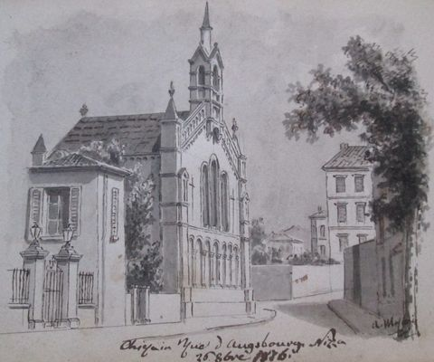
Lutheran Church, rue d'Augsbourg, Nice, 1876
Notes:
5

Slide 6
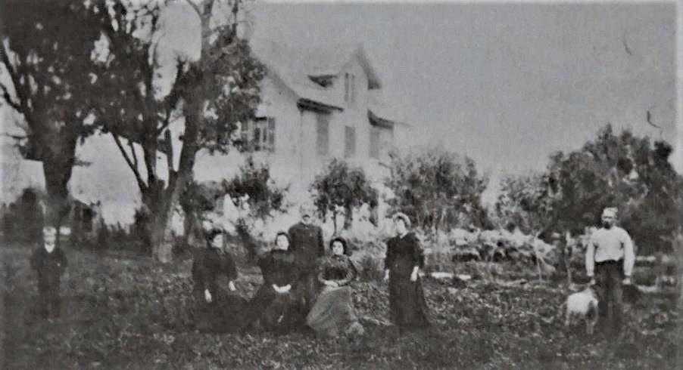
Mader family at Villa Alpina, Tenda, 1885
Notes:
6

Slide 7
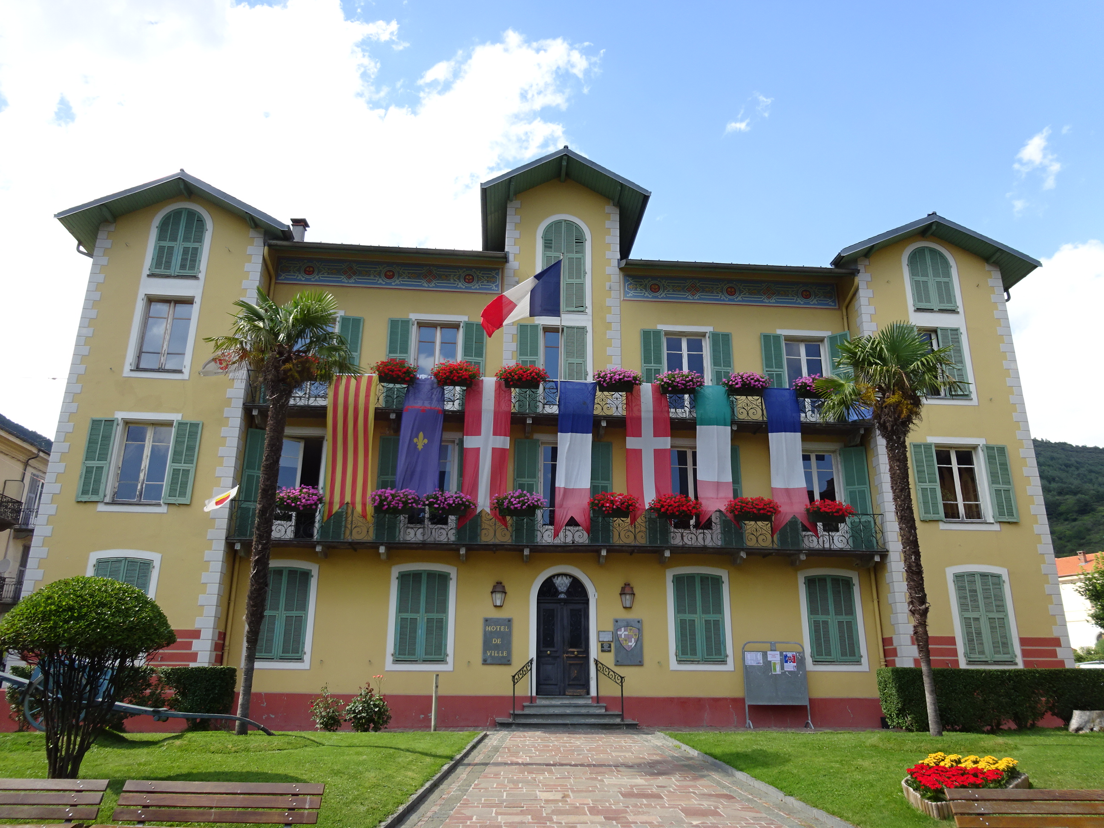
Mairie de Tende, 2018
Notes:
7

Slide 8
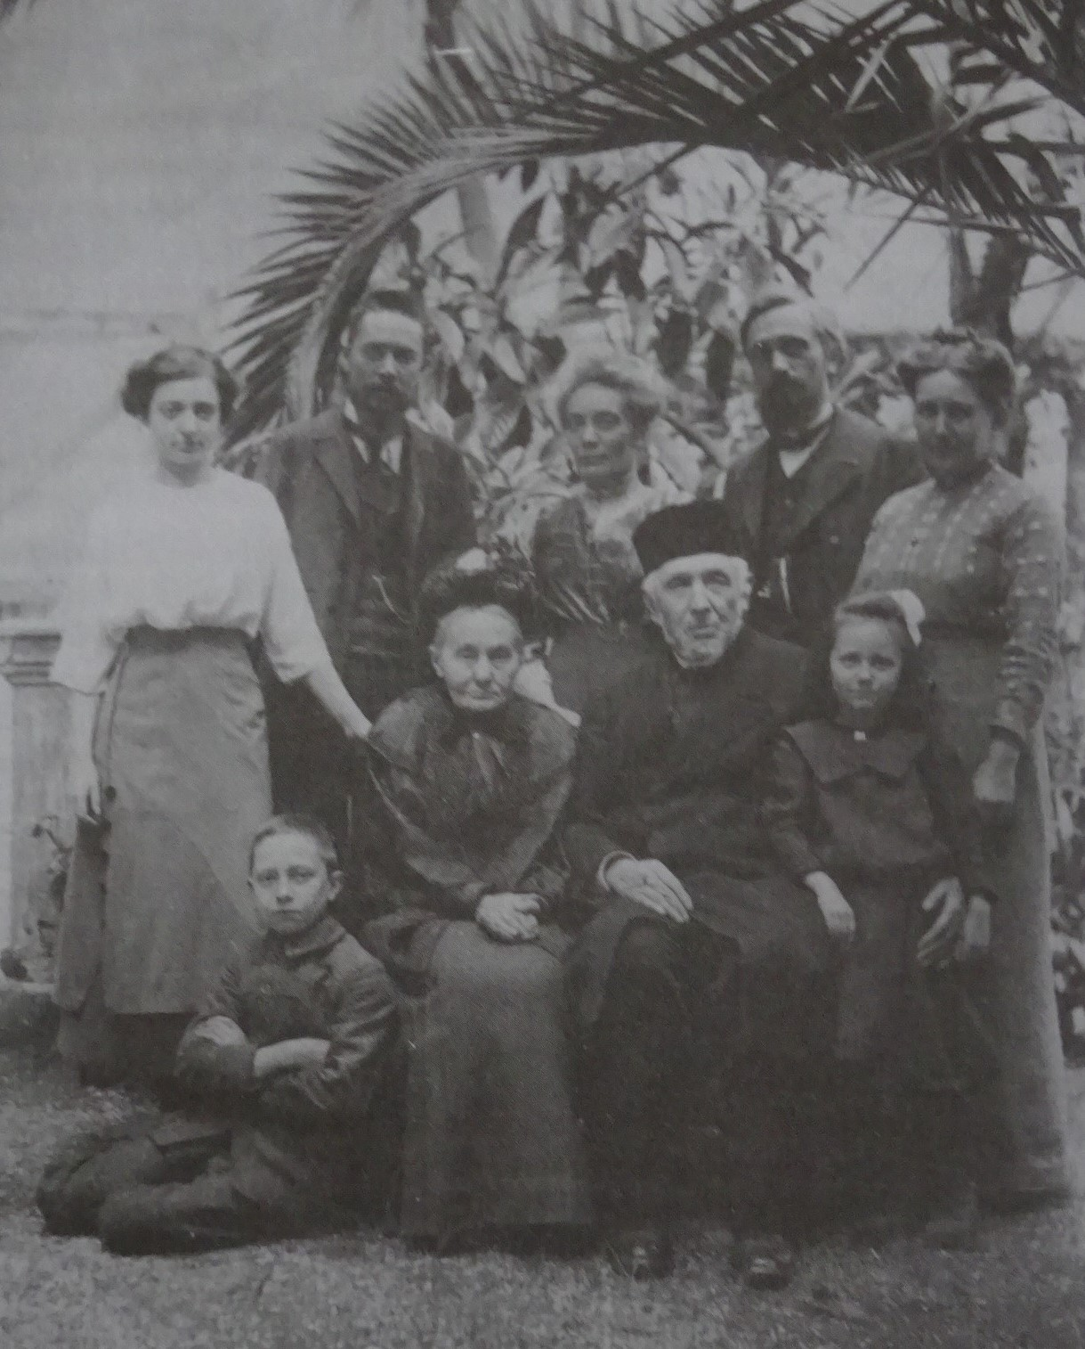
Mader family in Nice, 1911
Notes:
8

Slide 9
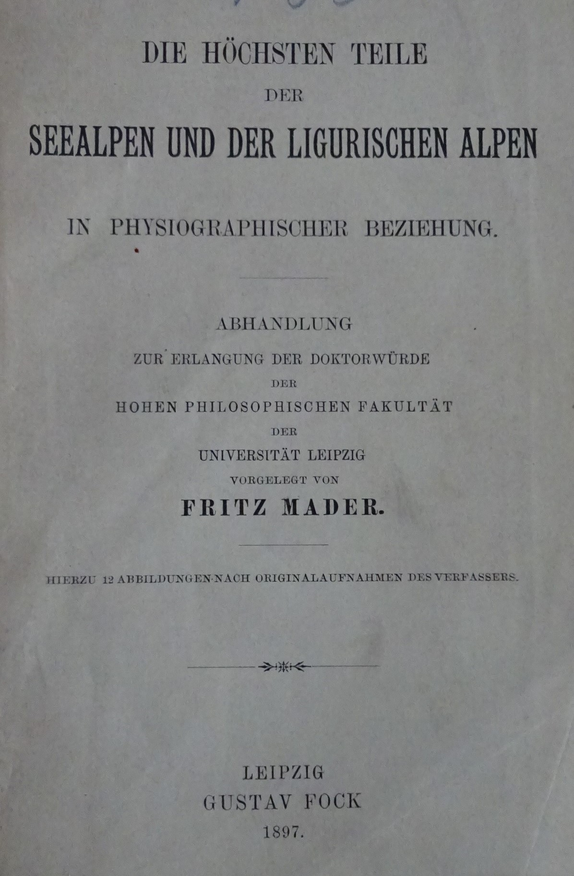
Doctoral Thesis, 1897
The physical geography of the highest parts of the Maritime and Ligurian Alps
Dissertation for obtaining a doctorate in the Faculty of Philosophy of the University of Leipzig
Submitted by Fritz Mader
Leipzig, Gustav Fock, 1897
Notes:
9

Slide 10
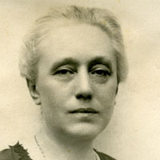
Memoirs of Frida Marin, Mader’s sister, 1938
‘What a fine character Fritz had! Good, generous, calm, always good-humoured and ready to have fun.
He jumped over precipices like a goat, and sometimes, to avoid freezing at night in the mountains, he covered himself with stones. If he didn’t die on the perilous climbs from which he brought back minerals and rare flowers, it was because he was protected by the hand of God.
Fritz never looked at a woman, and laughed at the idea of inspiring a woman’s love. If asked why he didn’t get married, he would reply ‘Why should I do that? Could I drag a wife with me into the mountains?’
'
Frida Maurin
Notes:
10

Slide 11
Loss of hearing
Frida recalled: ‘He wanted to become a pastor, but as a result of an illness when he was a teenager, his hearing was impaired. Consequently, he couldn’t hear when the organ stopped playing during church services, and he had to give up theology’
In 1900 Clarence Bicknell wrote: ‘Dr. Mader has just spent three days at my house in Bordighera. He's a well-educated young man, intelligent, but very deaf. He won't use a trumpet, so today I have a terrible sore throat’
Notes:
11

Slide 12
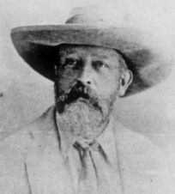
Clarence Bicknell (1842-1918)
‘I took a house in Val Casterino for the summer of 1897, and wrote to the Secretary of the Italian Alpine Club to ask if he could give me any information about the works published on the Meraviglie. He referred me to Dr. Fritz Mader, who had a thorough knowledge of the Maritime Alps, and spent his summers in Tenda. It was through the full and courteous reply to a letter that I wrote to Dr. Mader that we first heard of there being inscriptions in the valley near us (Val Fontanalba) and we immediately went up to search for ourselves’
Notes:
12

Slide 13
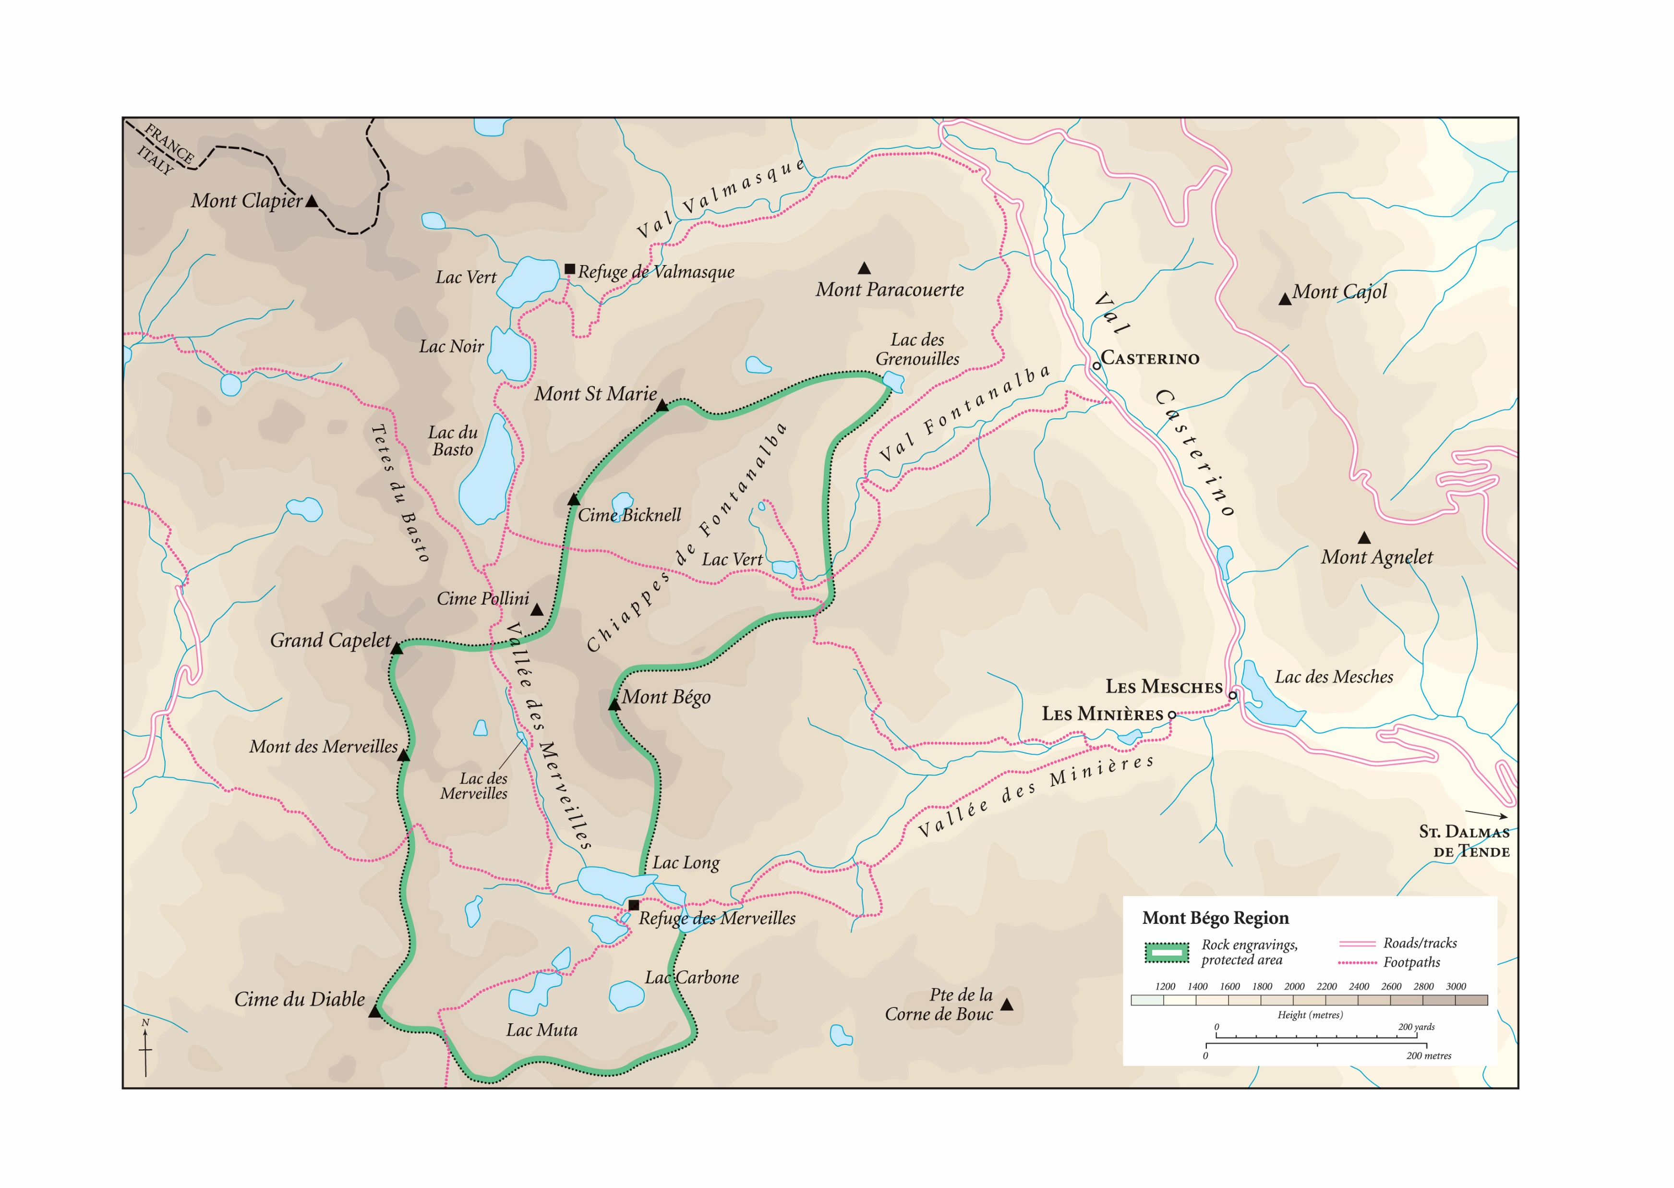
Notes:
13

Slide 14
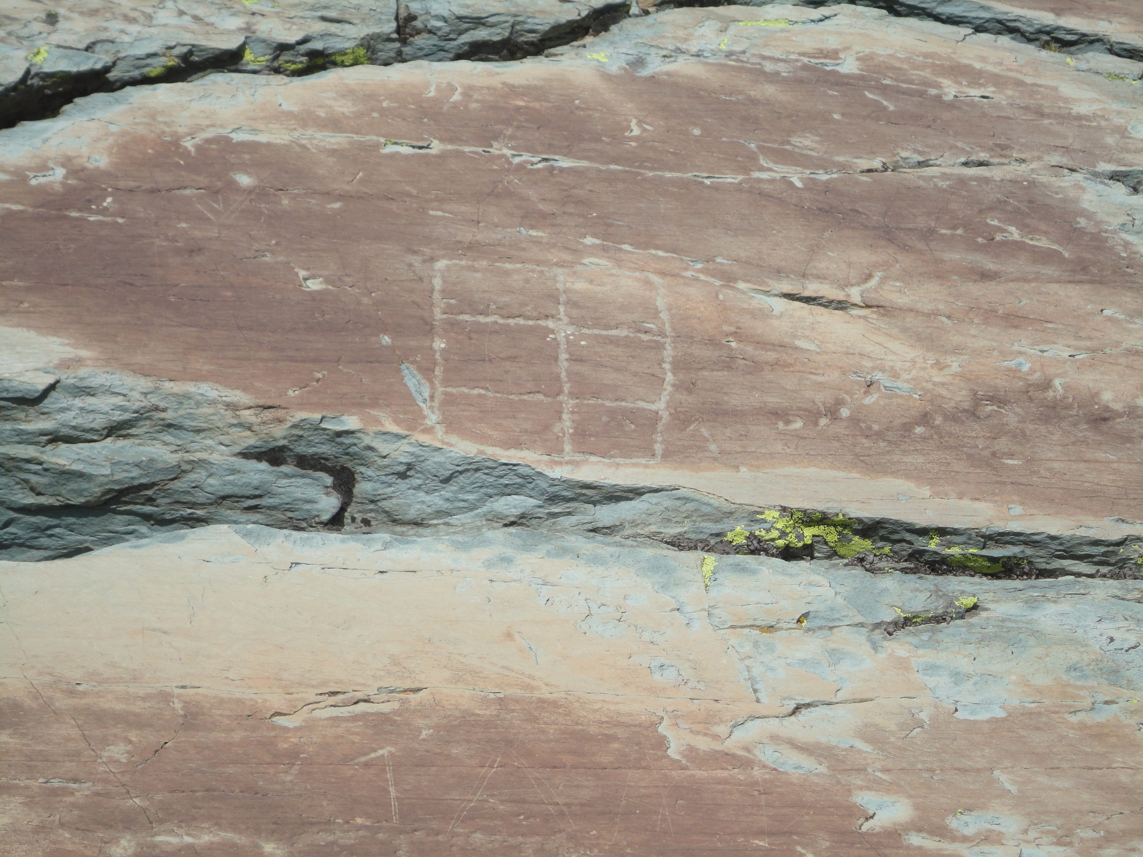
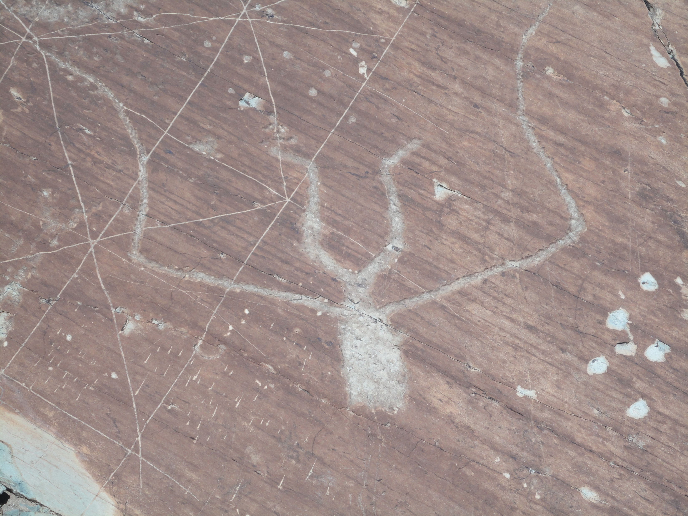
Rock engravings in Val Fontanalba
Notes:
14

Slide 15
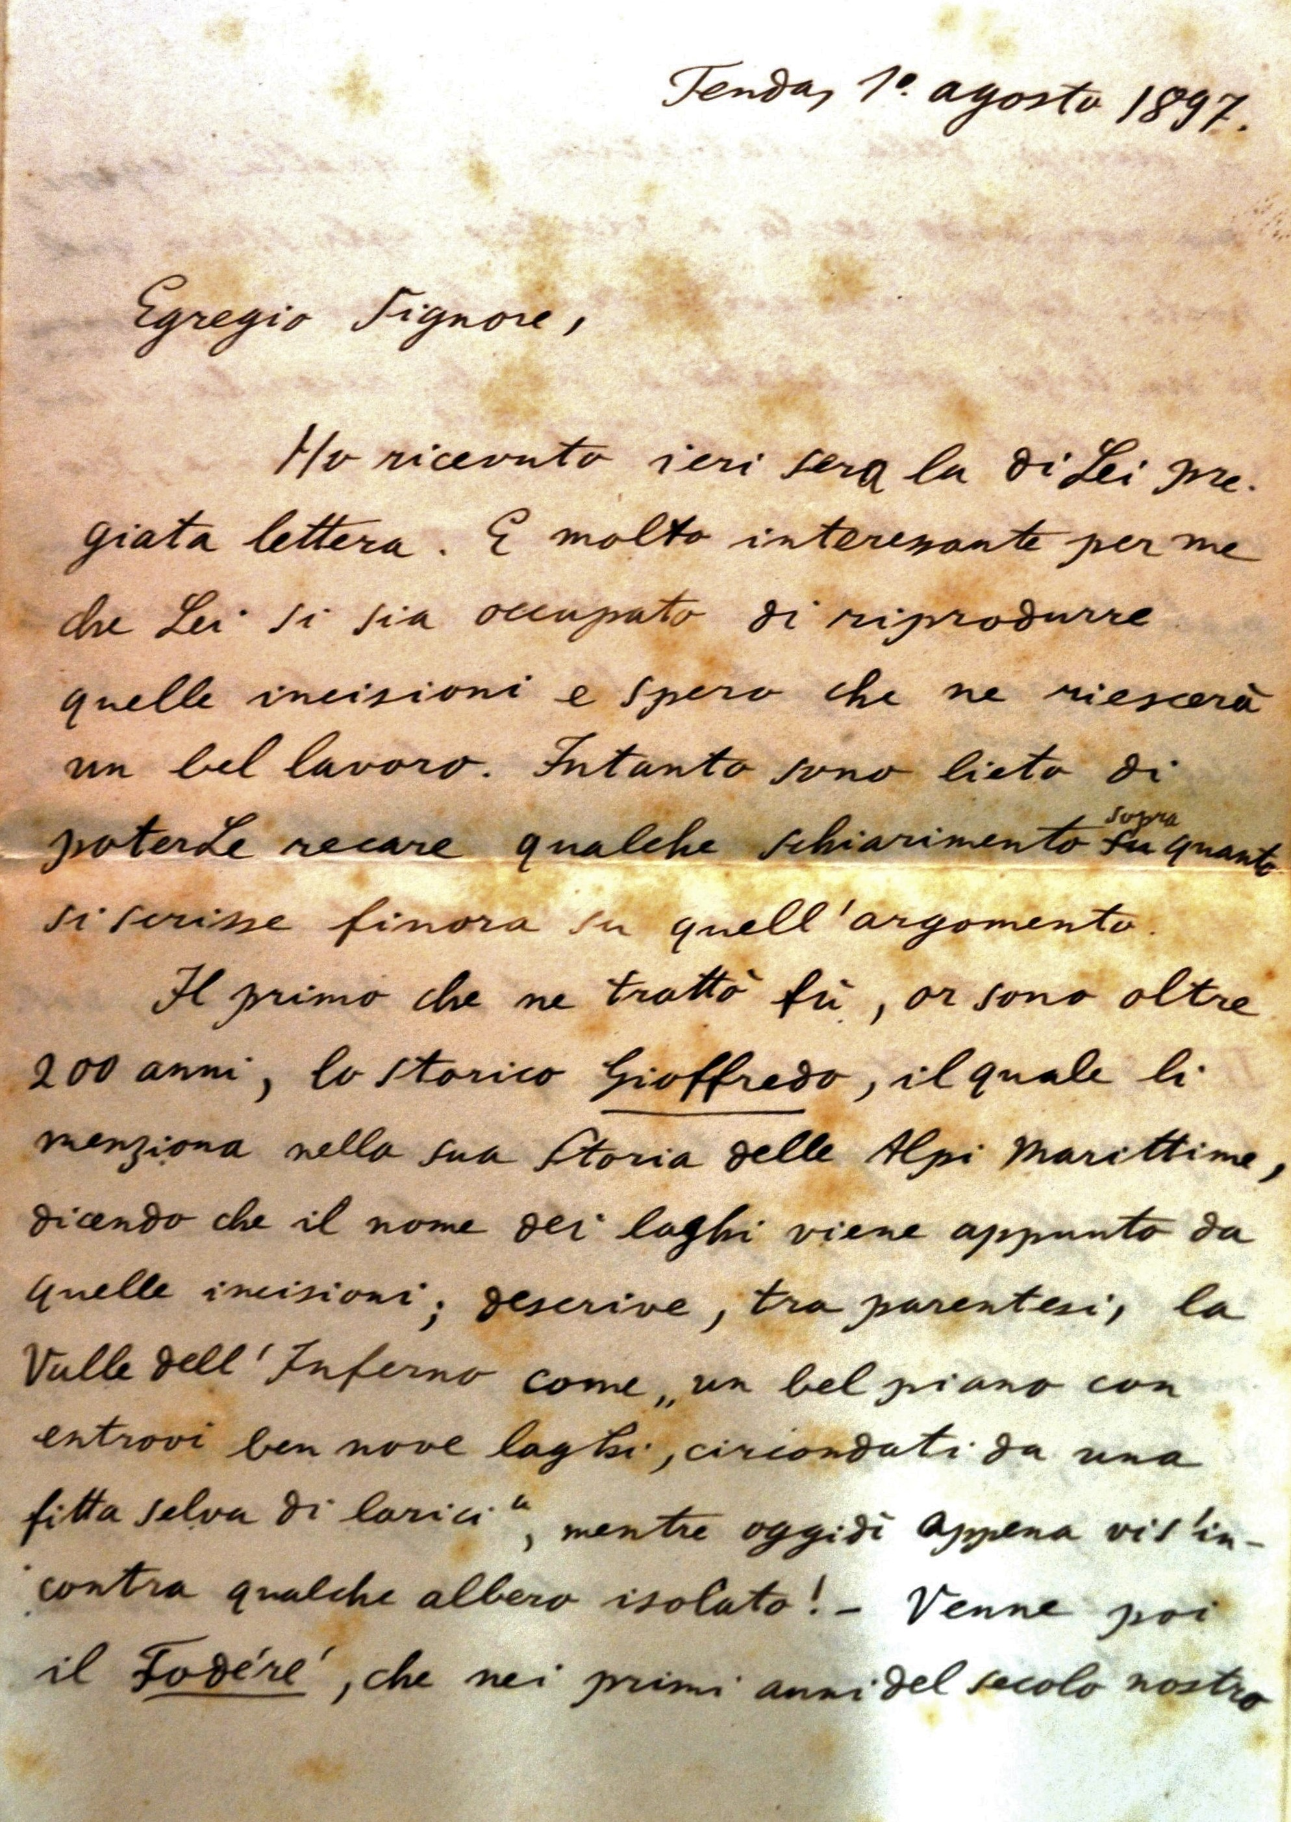
Letter of Mader to Bicknell
1 August 1897 (20 pages)
‘I received your valued letter yesterday. I’m happy to give you an explanation of what has been written up to now on the subject of the rock engravings. After so many theories propounded by others, I too would like to contribute something myself to clarifying the matter, though I think the final result will be to confess that we are confronted here by an enigma whose key can never be found’
Notes:
15

Slide 16
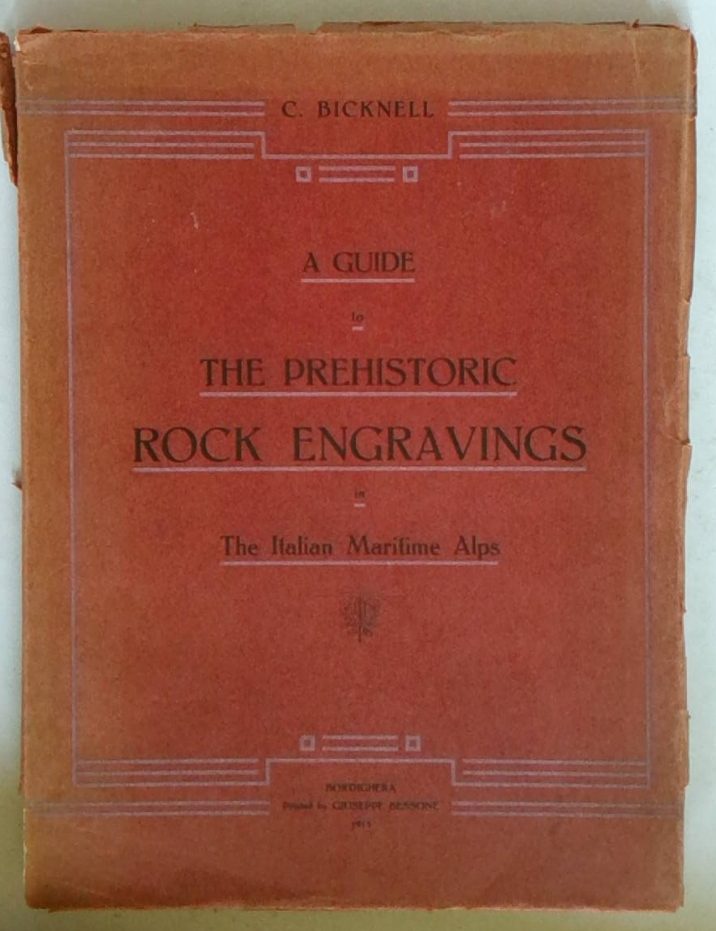
A Guide to the Prehistoric Rock Engravings in the Italian Maritime Alps, Clarence Bicknell 1914
Mader’s analysis influenced Bicknell’s ideas. Like Mader, he considered that:
the engravings were prehistoric, not made by Phoenicians or Hannibal’s soldiers
although they depicted metal weapons, they were made with stone tools
they were not made by herdsmen in their spare time, but offered to a divinity as part of a religious rite
Notes:
16

Slide 17
Mader on the rock engravings, 1903
‘Although the inscriptions provide us with information on the degree of civilisation of people of that period, showing us for example that the rearing of livestock and the growing of cereals in the region goes back to distant times, regrettably they cannot enlighten us further on the history of the human race. The random repetition of a few key figures, and the lack of any general method of organisation, does not allow us to deduce from them the kind of conclusions that may be drawn from even the most primitive writing’
Annales de la Société Des Lettres, Sciences et Arts des Alpes-Maritimes
Notes:
17

Slide 18
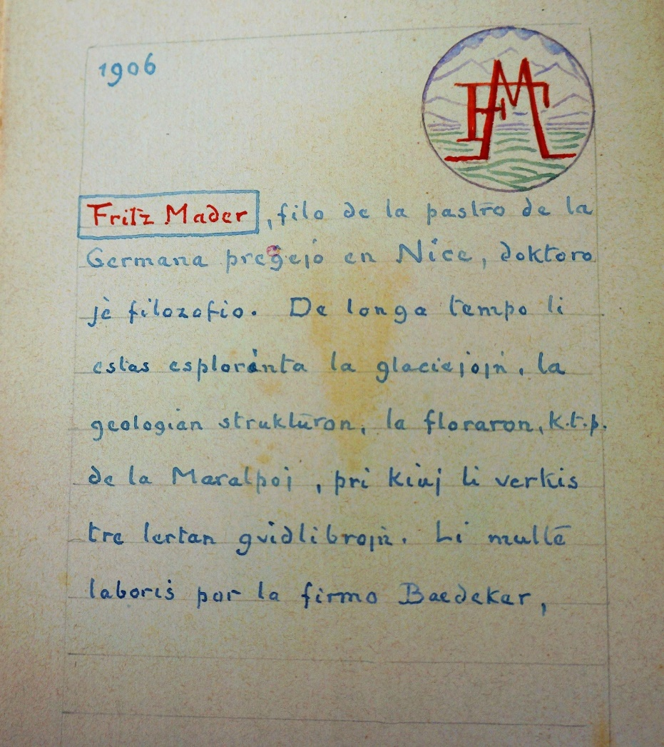
Clarence Bicknell’s Book of Guests in Esperanto
Fritz Mader, filo de la pastro de la Germana pregejo en Nice, doktoro je filozofio. De longa tempo li estas esplorinta la glaciejojn, la geologion strukturon, la floraron, k.t.p. de la Maralpoj, pri kiuj li verkis tre lertan guidilibrojn. Li multe laboris por la firma Baedeker
Fritz Mader, son of the pastor of the German church in Nice, Doctor of Philosophy. For a long time he has explored the glaciers, the geological structure, the flora etc. of the Maritime Alps, on which he has published very fine guidebooks. He works a lot for the firm Baedeker
Notes:
18

Slide 19
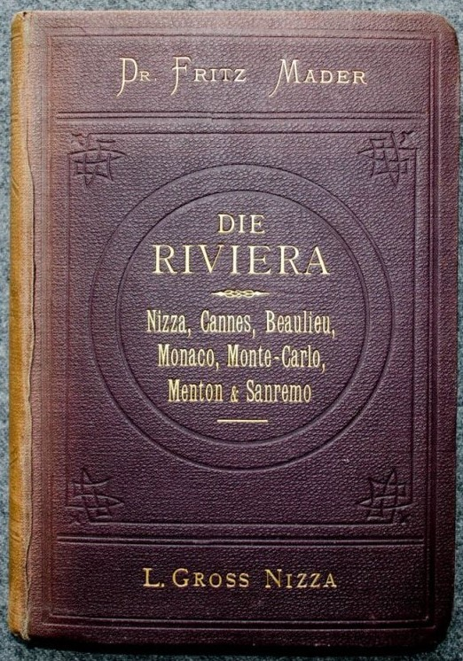
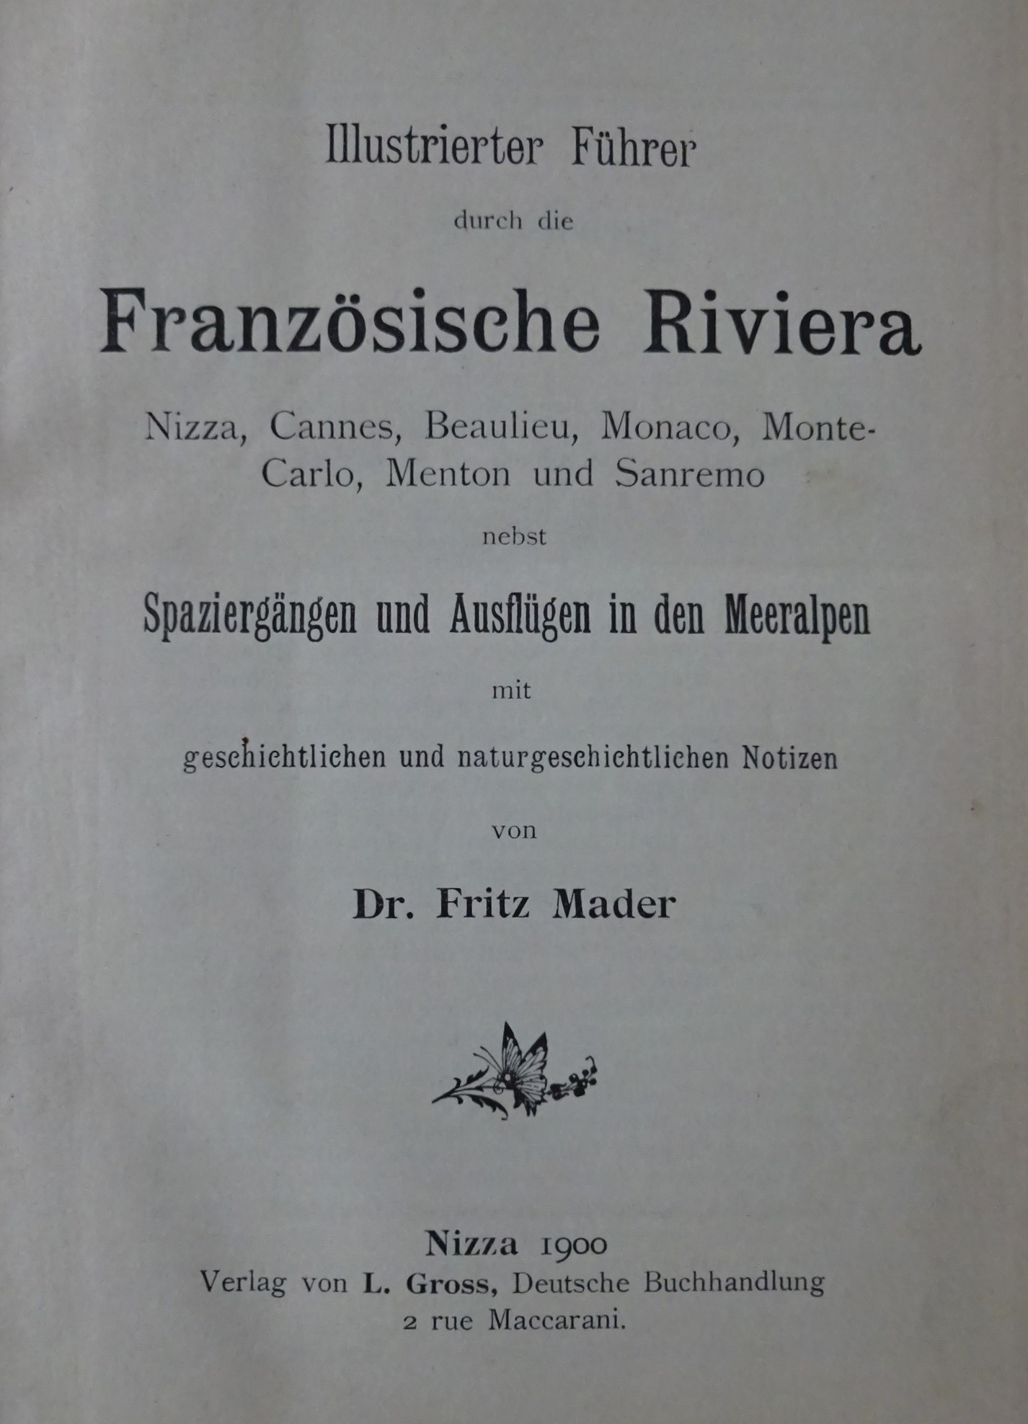
Notes:
19

Slide 20
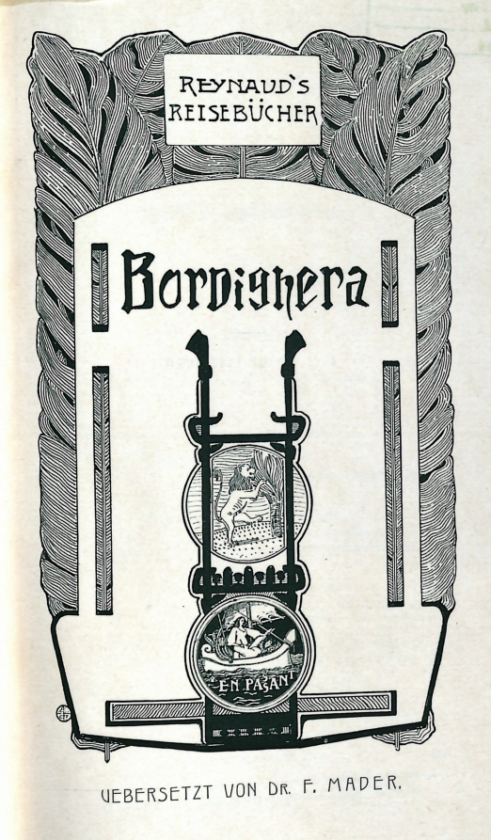

Notes:
20

Slide 21
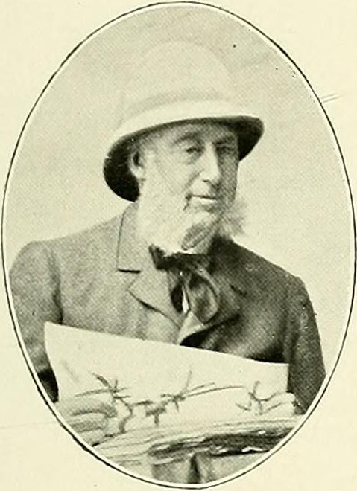
Emile Burnat (1828-1920)
‘We have recently obtained several recruits who often come to our aid: Dr. Fritz Mader, who lives in Nice during the winter and Tende in the summer, and is the author of various publications on the plants of the Maritime Alps and an excellent Guide to the Riviera, has provided us with a great deal of useful information, often accompanied by plants’
Flore des Alpes Maritimes Vol 4,1906
Notes:
21

Slide 22
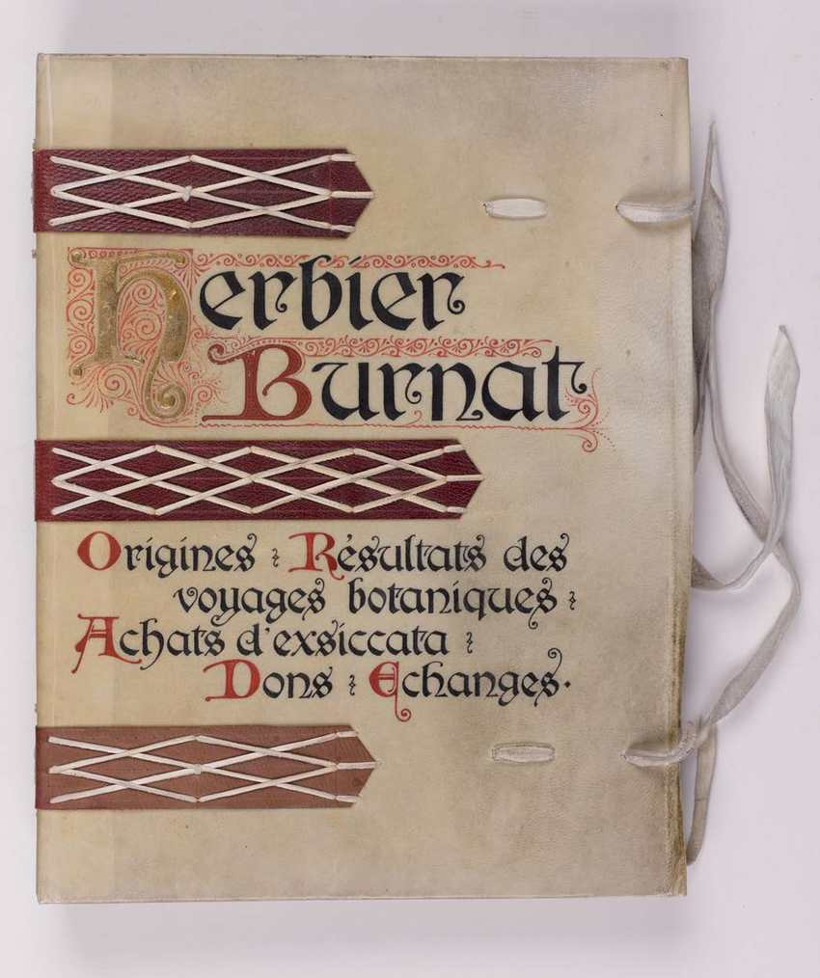
Herbier Burnat
Mader sent many letters and postcards to Burnat in the period 1901-15, asking botanical questions and reporting on plants that he had found
The specimens which he sent to Burnat are conserved in the Herbier Burnat in the Jardin botanique de Genève
Notes:
22

Slide 23
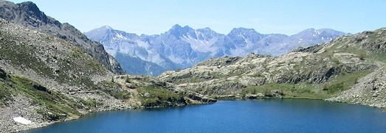
Mader’s love of the Alps
‘Blessed is he who, having his regular place of work in a great industrial city, nevertheless has the time and opportunity to spend part of the year in the Alps! Tired of my life’s monotony and my many studies, I have travelled every summer from Leipzig to Tenda. It’s there, in that invigorating climate, that I have been able to renew my strength and calm my nerves, and to discover a natural world that is so worthy of attention and study’
Notes:
23

Slide 24
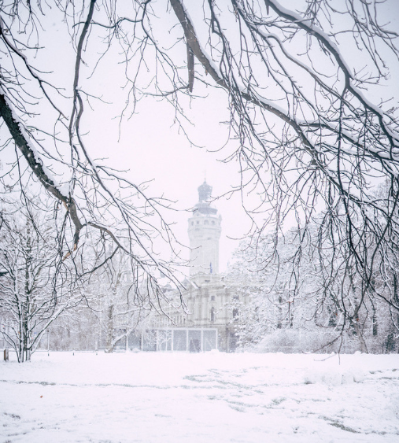
During the cold foggy winters in Leipzig, it has been a comfort to study the publications that I have found on the Alps and Alpine matters, and to put together what I could write myself about the mountains that I have explored. My work is no doubt full of gaps and defects, but what above all has encouraged me to pursue it is my love of the Alps, in which I have spent the best days of my life’
Notes:
24

Slide 25
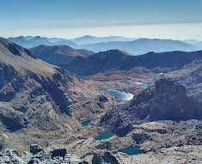
‘Let's ascend to the high peaks, where blows the lively air that restores body and soul. There we will see, lying below us, a richness and variety of enchantment. And if then we do not sense in ourselves some reflection of the eternal strength and virtue of nature, we will have lost the feeling that gives the greatest value to human life, and to which all progress is due: the love of high places’
Notes:
25

Slide 26
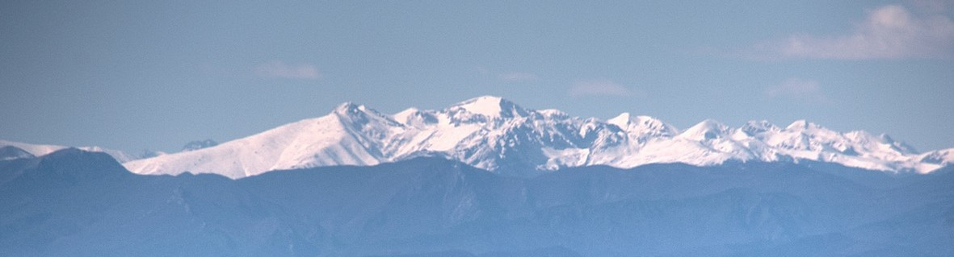
‘The Alps will always merit the attention of those who visit them in order to comfort body and mind, to exercise strength and courage, to see new things, or to study nature. A man who has nothing left to learn, to desire, or to love, has only death to wish for. The thirst for higher things, for ‘Excelsior’, is an essential condition of human progress. The desire to conquer, to know the Earth, and to search every corner of it, is innate in Man. Although this desire is respectable, one should not allow it to degenerate into a mania’
‘Personally, I have never considered the Alps as a gymnasium, but as a field of study, enjoyment, and healthy mental relaxation’

Slide 27
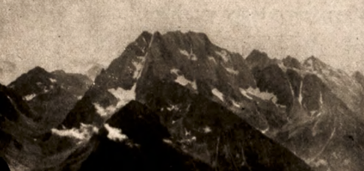
Photography
‘I have had the opportunity to pursue my geographical studies in a mountain country which is all the more attractive because it has retained the charm of the unexpected and the undisturbed. I have taken a large number of photographs of the scenery, for which I carry apparatus with plates of the kind which do not need to be changed’
Mader: Photo of the Argentera group

Slide 28
Excursions in the Mountains
In the period from 1892 to 1915 Mader published numerous articles in Il Rivista Mensile del Club Alpino Italiano describing his excursions in the
  Maritime Alps
  Ligurian Alps
  Mountains of Provence
  Dauphiné Alps (1903)
  Apuan Alps (1904)
  Cottian Alps (1904)
  Val d'Aosta (1907)

Slide 29
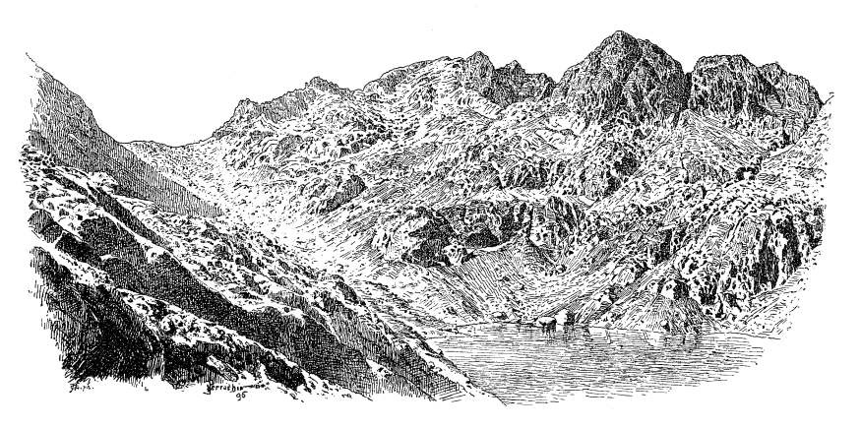
Mader : Baisse de Valmasque, Mont Capelet, Lac du Basto

Slide 30
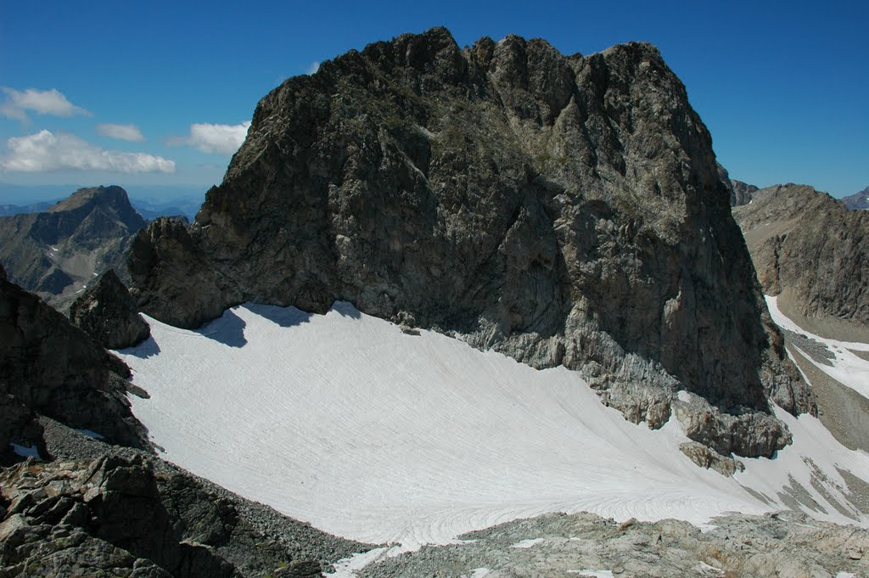
Ascent of Monte Clapier (3045 m.) in 1893
I made the ascent with Mr. Symington, a Scotsman. On our descent we reached a snowfield which had a slope of 30 degrees. We had no ice axe, crampons, or metal-tipped sticks, so there was nothing for it but to slide down. I could hardly restrain my laughter when I saw Mr. S. roll down, legs and arms in the air, with his effects flying here and there; he tried to sit on his wool jacket, but it stayed behind.

Slide 31
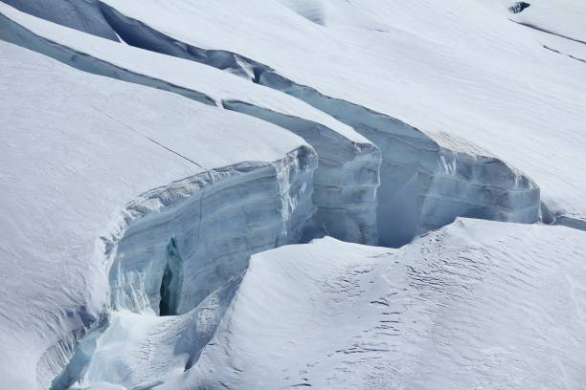
On my side, the slope was steeper, and after leaping over a narrow deep crevasse, I was impelled downwards with dizzying speed on hard and uneven snow, jolted and shaken by leaps of increasing speed and size. I could have broken my bones, but I only tore the skin of my fingers trying to stop myself. Then I saw Mr. S. attempting in vain to recover his jacket. I succeeded in doing so after cutting steps with my camera tripod, and then with a penknife. Then I slid back down again.

Slide 32
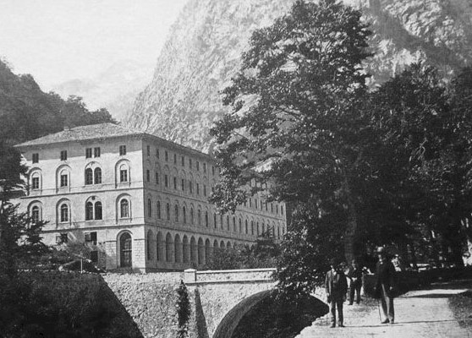
Finally we reached Terme di Valdieri, where we were greeted by festive music. But it wasn’t in our honour. The waiters were not happy to see our brigand-like appearance, which contrasted with the beautiful dresses of the ladies and the brilliant uniforms of the officers.
Terme di Valdieri

Slide 33
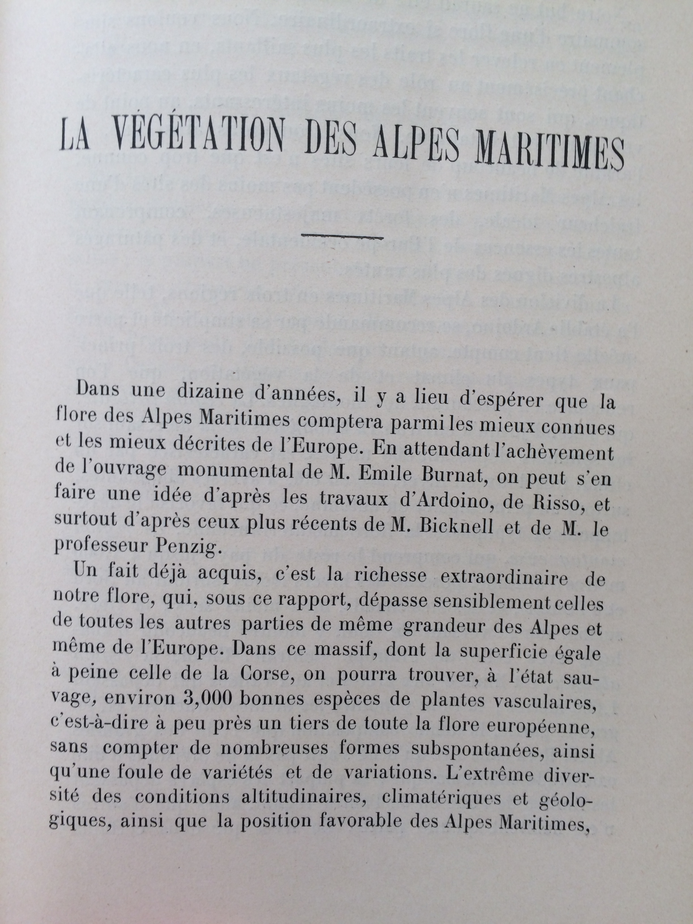
Plants of the Maritime Alps, 1903
‘Our flora is extraordinarily rich, surpassing those of other areas of similar size in the Alps, and even in Europe. It includes about 3,000 vascular plants growing in the wild, nearly a third of the European flora. The main reasons for this richness are the extreme diversity of climate, altitude and geology, and the favourable position of the Maritime Alps’

Slide 34
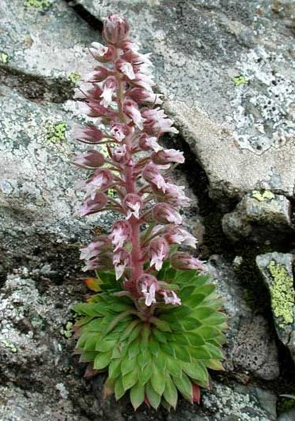
‘I must pay tribute especially to Saxifraga florulenta, which has been described by Mattirolo as ‘the finest of all the saxifrages, the treasure of the Maritime Alps’. It is found only in the central massif of the Maritime Alps, between the rivers Tinée and Roja, on vertical, dry, shady rock-faces above 2,000m. Since each rosette blooms only once in its long life, it is rarely seen in flower. It may be collected only by the valiant, the patient, and the lucky’

Slide 35
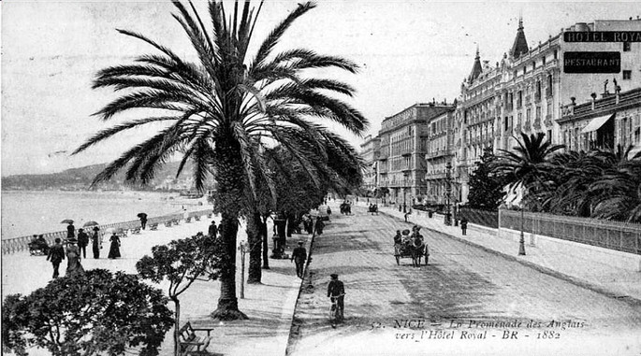
Flora of the gardens of the Riviera, 1912
‘What strikes travellers from the North most are the palm trees. The number of species grown in the open today is around a hundred, of which the oldest introduction and the most widespread is the date palm Phoenix dactylifera. On the sandy soil of Bordighera the date palm is cultivated on a large scale for its young leaves, which are used in Catholic and Jewish worship’
Promenade des Anglais, Nice, 1882

Slide 36
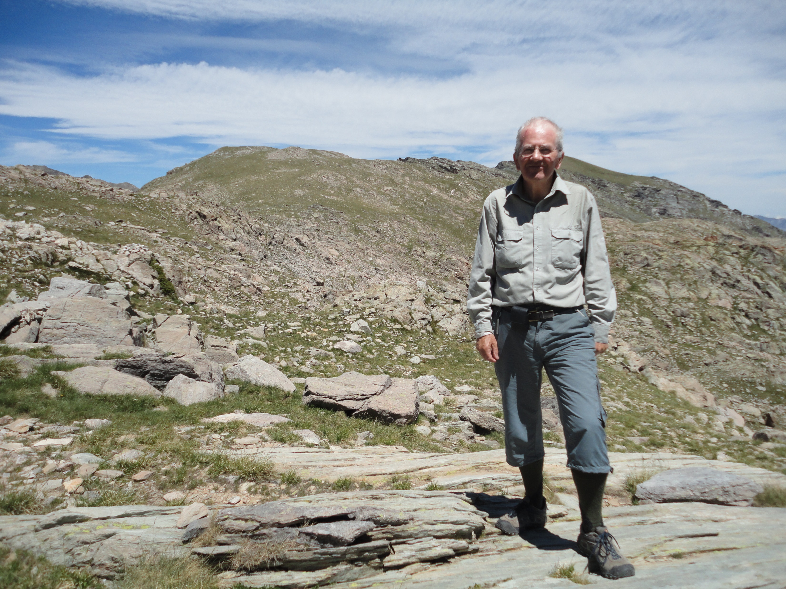
Cima Bicknell (2,600 m.)
‘I went up Val Fontanalba on to the ridge between Baissa Fontanalba and Monte Santa Maria. Here is a long summit with several tops, which deserves a name. One could not do better than to think of Mr. Clarence Bicknell, who for many summers has been exploring the prehistoric rock engravings in this region’
Fritz Mader, 1907
Graham Avery, 2012

Slide 37
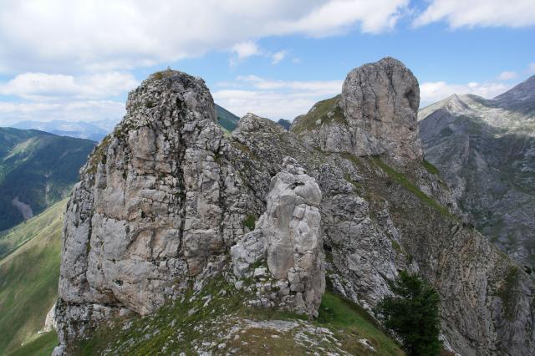
Dente Mader & Torrione Mader (2,200m.)

Slide 38
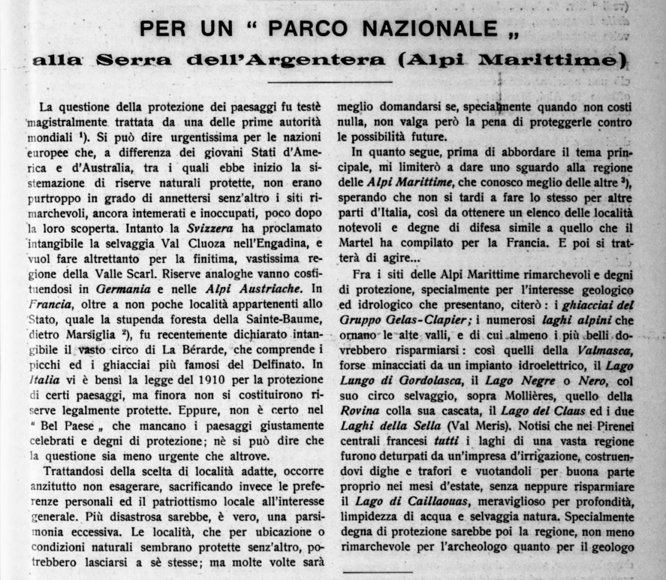
A National Park in the Argentera
Rivista Mensile del Club Alpino Italiano, 1914
In this article Mader proposes the creation of a National Park in the Argentera. He lists the sites which need protection, especially where trees are threatened by damage or deforestation, or local flora needs to be protected. He mentions about 100 species of flowers, shrubs and trees which grow in the Maritime and Ligurian Alps.

Slide 39
The Parco Naturale dell'Argentera was finally created in 1980, adjacent to the Parc national de Mercantour created in 1979.
It became the Parco Naturale delle Alpi Marittime in 1995.
‘Among the sites that deserve protection for their geological and hydrological interest are the glaciers of the Gelas-Clapier group and the alpine lakes of the high valleys. For archaeologists, geologists and tourists, the area of the Laghi delle Meraviglie and upper Val Fontanalba also deserve protection. If the Club Alpino Italiano were to take the initiative on the question of a National Park, it would have allies, and it would be a useful and noble task’

Slide 40
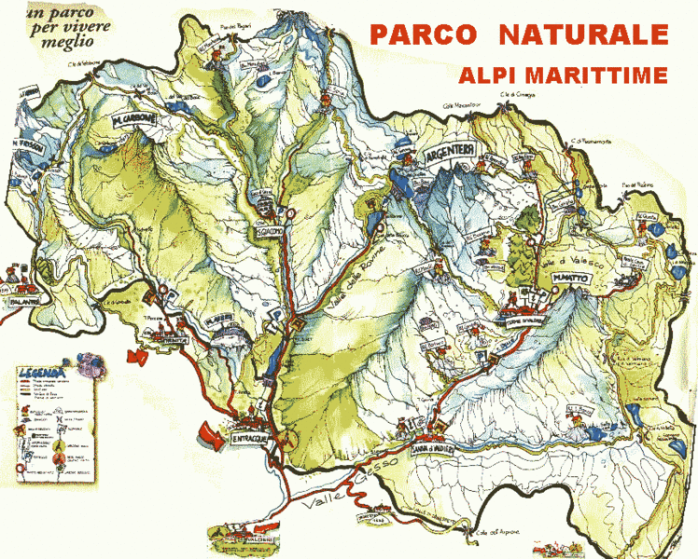

Slide 41
War
Letter of Mader to Burnat, May 1915
‘In 1914 our house in Nice was entered by a gang who committed damage everywhere. What remained of our personal belongings was then sold at auction, some of them at a low price, such as a good harmonium for 100 francs. Our friends were able to save very little. Seeing that the situation was hopeless, I decided to leave Italy in April 1915, without being able to see the spring flora in bloom in the high valleys’
Letter of Bicknell to Burnat, October 2015
‘According to the newspapers in Nice, the police visited Pastor Mader's house, and found compromising correspondence from his son. I don't believe at all that Fritz Mader was a spy. He was well regarded by the Italian officers, he had permission to photograph everywhere, he knew the Italian Maritime Alps well, and he often wrote for the Alpine Club. This meant, of course, that in his letters he wrote of passes, roads, summits, etc. I’m convinced that everything he did was in the pursuit of geography’

Slide 42
Memoirs of Frida Marin, 1938
‘Fritz was never involved in politics. The mountains were his homeland. To treat him as a spy, this man who remained an innocent youth, in love with nature, merely because they found in a chest more than 6,000 photographic plates of the mountains. He always sent copies of them to the military commanders at Genova and Marseilles, for which they thanked him, saying that his scrupulous observance of the law had provided them with a magnificent collection of photographs’

Slide 43
Fritz Mader’s last years
Frida wrote: ‘Fritz was employed in the censor’s office in Stüttgart. As a result of being shut inside all day, after being used to the open air, he fell ill with tuberculosis and a bone disease, so that he walked hunched up like a 90-year-old. Later he was employed in the library, where he went on crutches.
It was a great sadness for him that he never again saw his Alpine Flora and other books that were dear to him, for they were stolen. Until his very last days he was working on a book on the Maritime Alps, which after his death was borrowed by a friend, along with other manuscripts, but they were never returned.
He fell asleep in the arms of my sister Käthe, just before his 49th birthday’

Slide 44
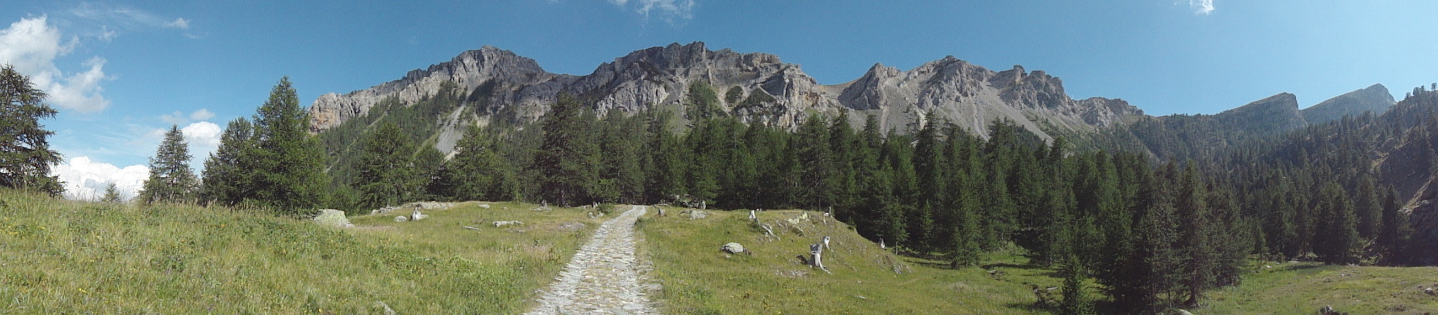
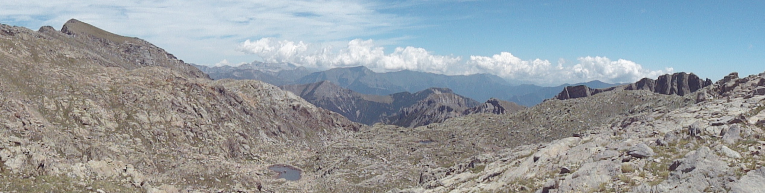
Val Fontanalba

